Slide 1

Project Title -
Arun Kumar Singh
AICTE ID : APPLY_17643159816929534d1a3bd

Slide 2

PROBLEM STATEMENT
Detection of Unknown Threats: Traditional systems fail against "zero-day" attacks. AI must learn behavioral baselines to identify novel threats.
High False Alarm Rates: Differentiating between rare but benign activity and actual malicious intrusions remains a primary hurdle, as both can appear as "anomalies".
Data Imbalance: In real-world network traffic, normal packets vastly outnumber attack packets. This "class imbalance" often leads AI models to be biased toward normal traffic, causing them to miss critical, rare attacks.
Real-time Processing Demands: Analyzing high-throughput network traffic at line speed requires significant computational resources, often leading to latency bottlenecks.
Adversarial AI: Attackers now use AI to craft "adversarial inputs"—subtly modified traffic designed specifically to bypass or "poison" detection models.
Lack of Explainability: Many AI models (especially deep learning) act as "black boxes," making it difficult for security analysts to understand why an alert was triggered, which hinders effective incident response

Slide 3
Project Description
Modern NIDS projects are built upon a multi-stage architecture designed for high-throughput, real-time environments:
Data Acquisition & Collection: Uses sensors like Snort, Wireshark, or TCPDump to capture live network traffic as PCAP files.
Feature Extraction: Converts raw packets into structured flow-based features using tools like CICFlowMeter or custom C-based sniffers.
Preprocessing: Includes data normalization (e.g., UTF-8 encoding), handling missing values, and addressing class imbalance—where normal traffic vastly outweighs malicious data—to ensure the AI does not become biased.
AI Engine (Models):
Supervised Models: Random Forest, SVM, and K-Nearest Neighbors (KNN) for classifying known attacks like DoS or Brute Force.
Deep Learning Models: CNNs for spatial pattern recognition in traffic and LSTMs for analyzing sequential time-series data to detect stealthy, multi-stage attacks.
Anomaly Detection: Autoencoders and GANs (Generative Adversarial Networks) that learn "normal" behavior and flag any deviation, enabling the detection of previously unseen zero-day threats

Slide 4

WHO ARE THE END USERS?
As cyber threats have become more sophisticated, the user base has evolved from specialized security researchers to a diverse group of operational, management, and specialized technical personnel.
1. Primary Operational Users (Security Teams): These users interact with the NIDS daily to maintain the organization's security posture.
2. Specialized Technical & Engineering Roles: A new class of users has emerged in 2026 to manage and optimize these complex AI systems
3. Management & Governance Users: Executive-level users utilize NIDS outputs for strategic risk management and compliance
4. Organizational & Industry Sectors: AI-based NIDS are critical for sectors with high-value data or critical infrastructure

Slide 5

Technology Used
AI-based Network Intrusion Detection Systems (NIDS) leverage a sophisticated stack of machine learning, deep learning, and specialized security frameworks to manage high-speed data and sophisticated threats.
1. Artificial Intelligence & Machine Learning Architectures
Modern systems have moved beyond simple "shallow" models to hybrid and specialized deep learning (DL) architectures
Deep Learning Models: CNN (Convolutional Neural Networks, LSTM & BiLSTM (Long Short-Term Memory, Autoencoders (AE)
Ensemble & Hybrid Models: XGBoost-CNN-LSTM: ,Random Forest & CatBoost
2. Feature Extraction & Data Preprocessing
3. Explainability & Transparency (XAI)
4. Implementation & Deployment Technologies
5. Emerging Trends for 2026
Graph Neural Networks (GNNs): Emerging as a tool to map complex entity relationships and uncover subtle, multi-hop lateral movements within a network

Slide 6
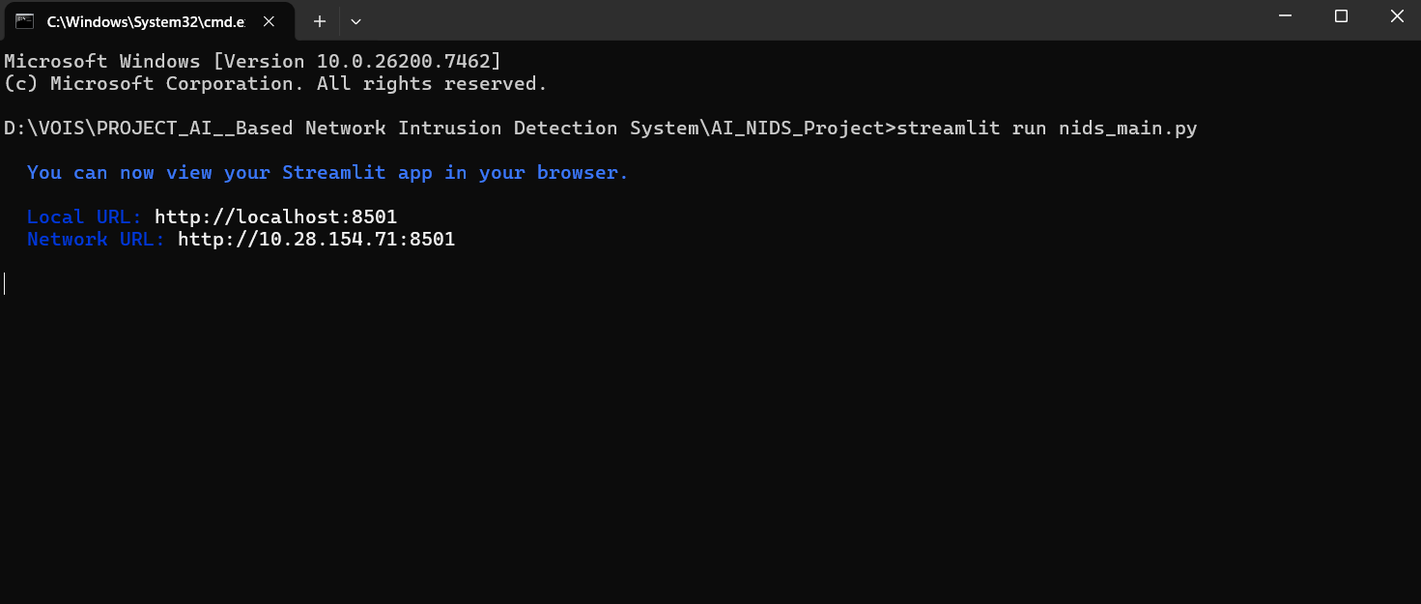
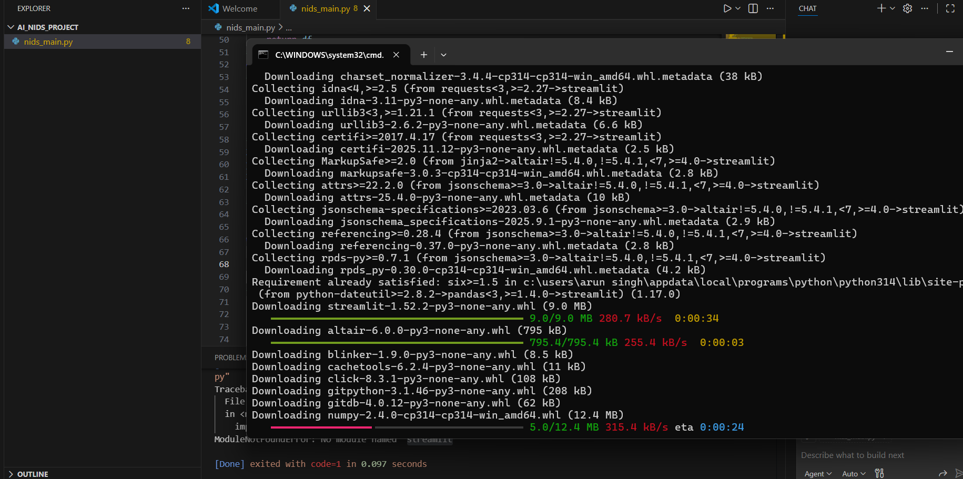
RESULTS
Demo Link

Slide 7
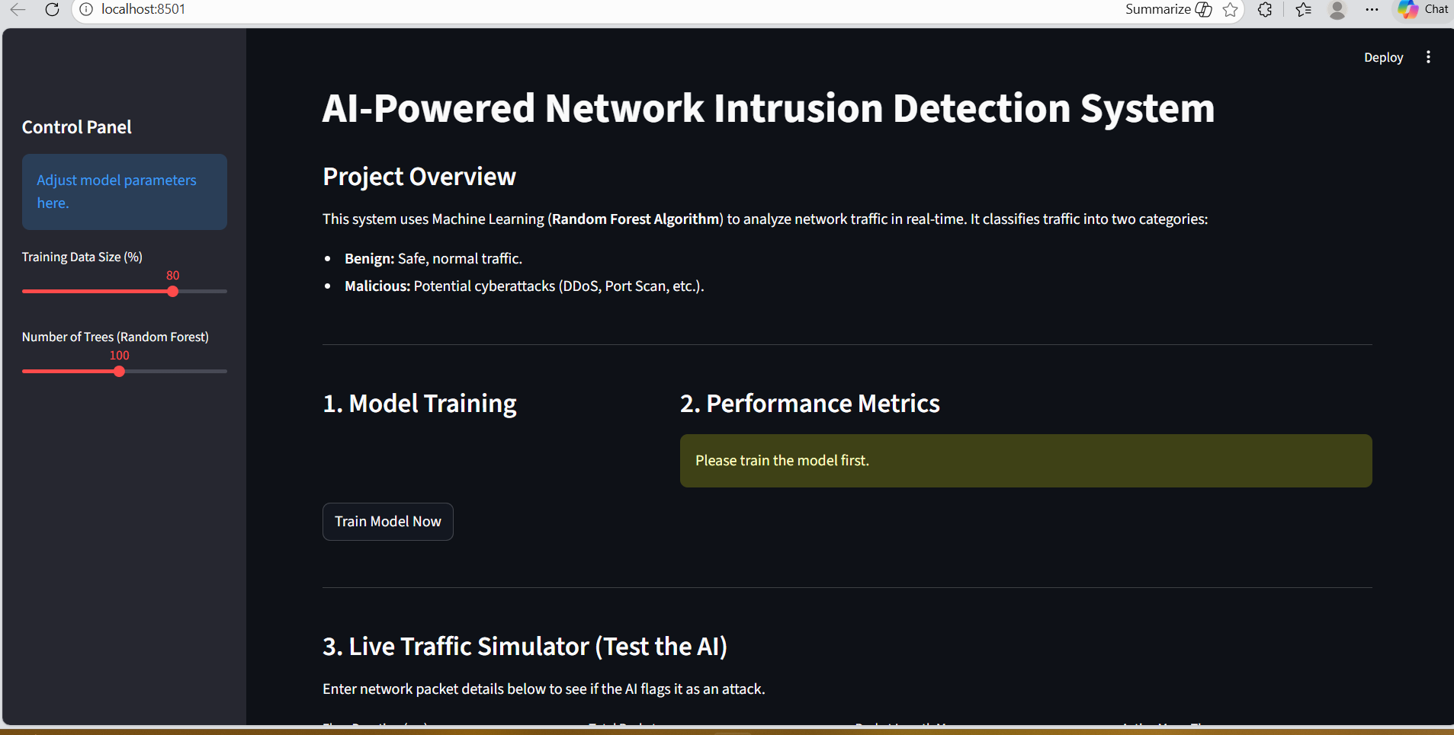
RESULTS
Demo Link

Slide 8
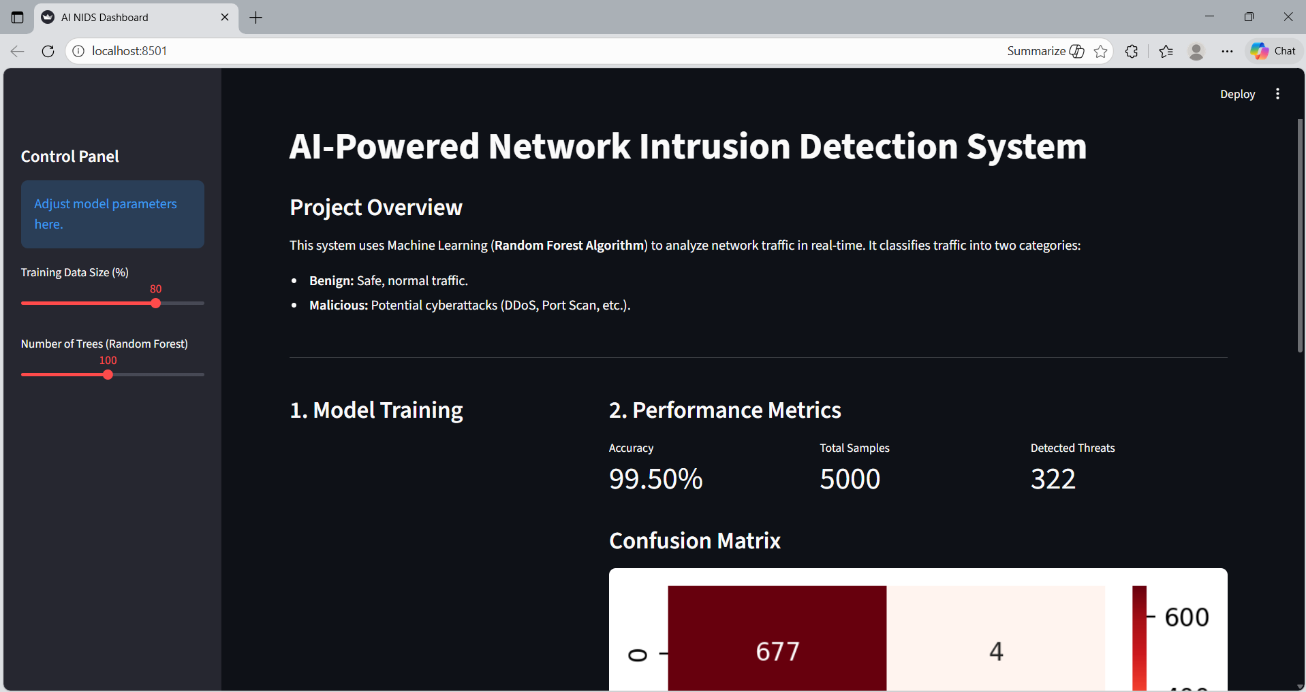
RESULTS
Demo Link

Slide 9

Certificate - Protection from browser attacks

Slide 10

Certificate - Introduction to System Security

Slide 11

Certificate - Securing Android Devices

Slide 12
GitHub link

Slide 13
Thank you
.
.

